Slide 1
Simple, Fast, and Practical Concurrent Queue Algorithms
Based on Michael and Scott, 1996
Hugo Wan

Slide 2
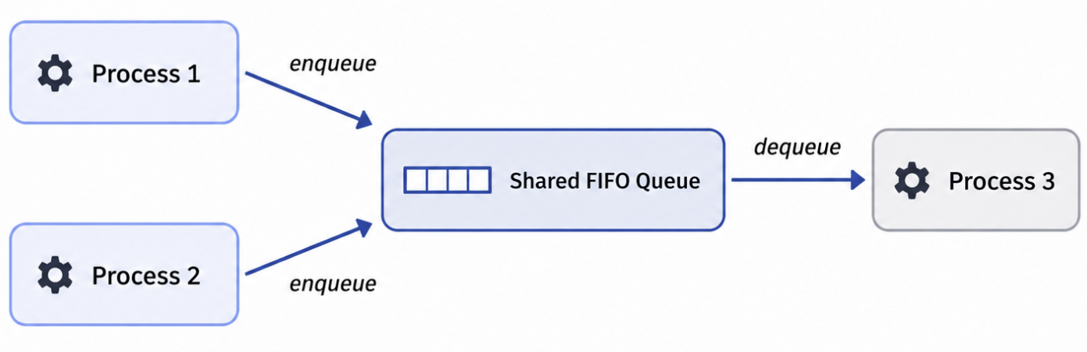
Motivation: Why Concurrent Queues Matter
FIFO queues are widely used in parallel applications and operating systems.
Multiple processes may enqueue and dequeue at the same time.
Concurrent access must be synchronized to avoid corrupted queue state.
A delayed process can hurt performance if the queue relies on blocking synchronization.
The paper studies practical queue designs that are simple, fast, and safe.
Multiple processes can access the same FIFO queue concurrently, so the queue needs synchronization to preserve correctness.

Slide 3
Blocking vs. Non-Blocking Queues
Queue Design | Main Mechanism | Strength | Limitation
Single-lock queue | One global lock | Very simple | Only one operation can proceed at a time
Two-lock queue | Separate head and tail locks | One enqueue and one dequeue can overlap | Still vulnerable to delayed lock holders
Non-blocking queue | CAS / LL-SC atomic operations | System can keep making progress despite delays | More complex pointer logic
Earlier non-blocking queues | Snapshots or reference counting | Avoid ordinary locks | Higher overhead or memory-management issues
The paper compares blocking and non-blocking queue styles to show why a practical lock-free queue is useful under contention and process delays.

Slide 4
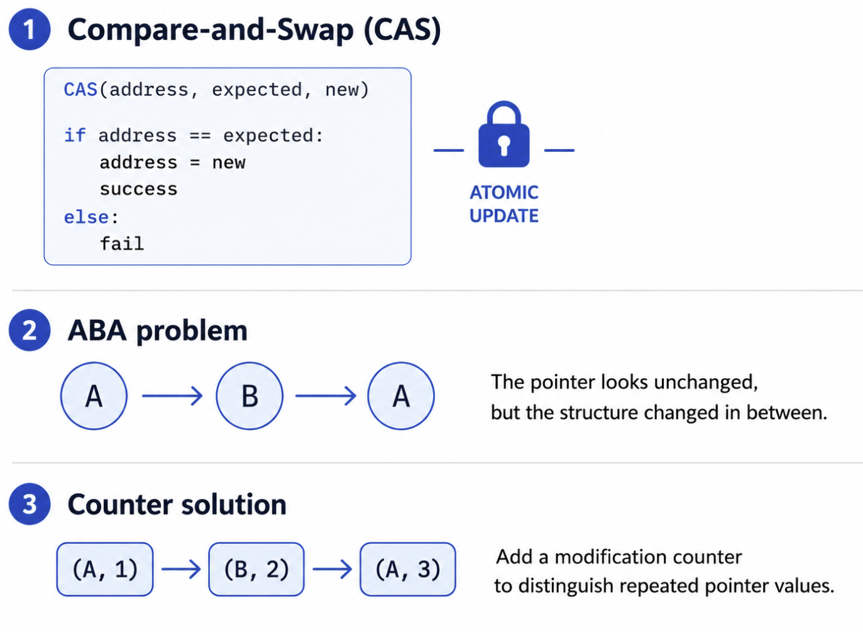
CAS and the ABA Problem
The non-blocking queue relies on compare-and-swap, or CAS.
CAS changes a shared value only if it still matches the expected old value.
This allows pointer updates without locks.
CAS-based algorithms must handle the ABA problem.
The paper stores pointers with modification counters to reduce ABA risk.
CAS enables lock-free pointer updates, but pointer-count pairs are used to reduce the chance that an ABA change is mistaken as no change.

Slide 5
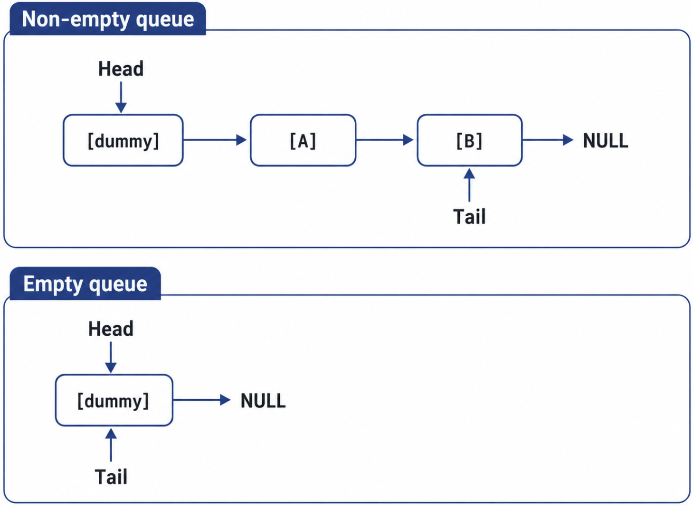
Non-Blocking Queue Data Structure
The queue is implemented as a singly linked list.
Head and Tail are shared pointer-count pairs.
Head always points to a dummy node.
The first real queue item is stored at Head->next.
The dummy node simplifies empty and single-item queue cases.
The non-blocking queue uses a dummy node at the head of the linked list, so dequeue can advance Head instead of removing a special first node.

Slide 6
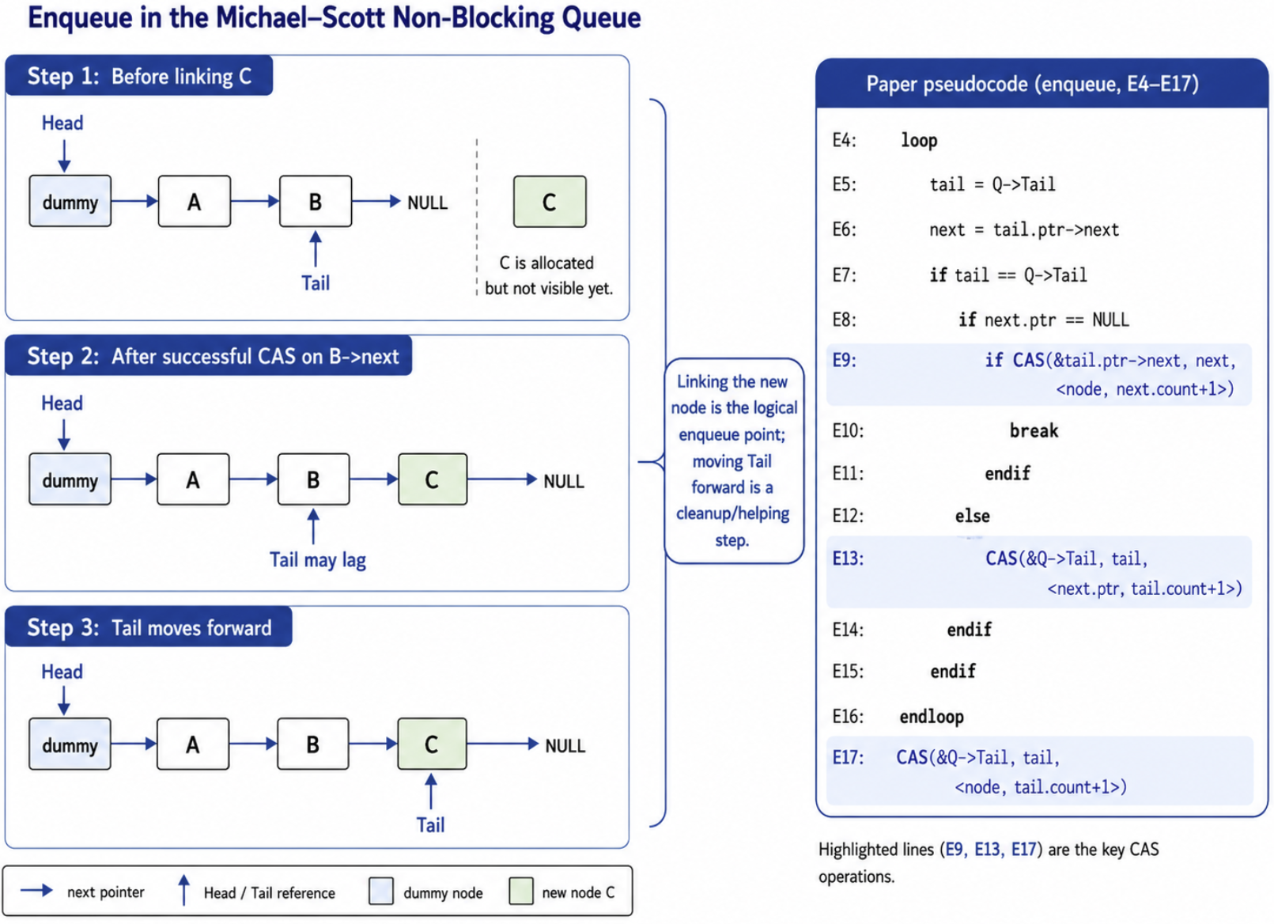
Enqueue Operation: Link First, Then Update Tail
Enqueue allocates a new node and sets its next pointer to NULL.
It reads the current Tail and Tail->next.
If Tail->next == NULL, the process tries to link the new node using CAS.
The successful link is the logical enqueue point.
Updating Tail afterward is a cleanup step, not the moment the item enters the queue.
Enqueue takes effect when CAS links the new node at the end of the list; moving Tail forward only helps future operations find the end faster.

Slide 7
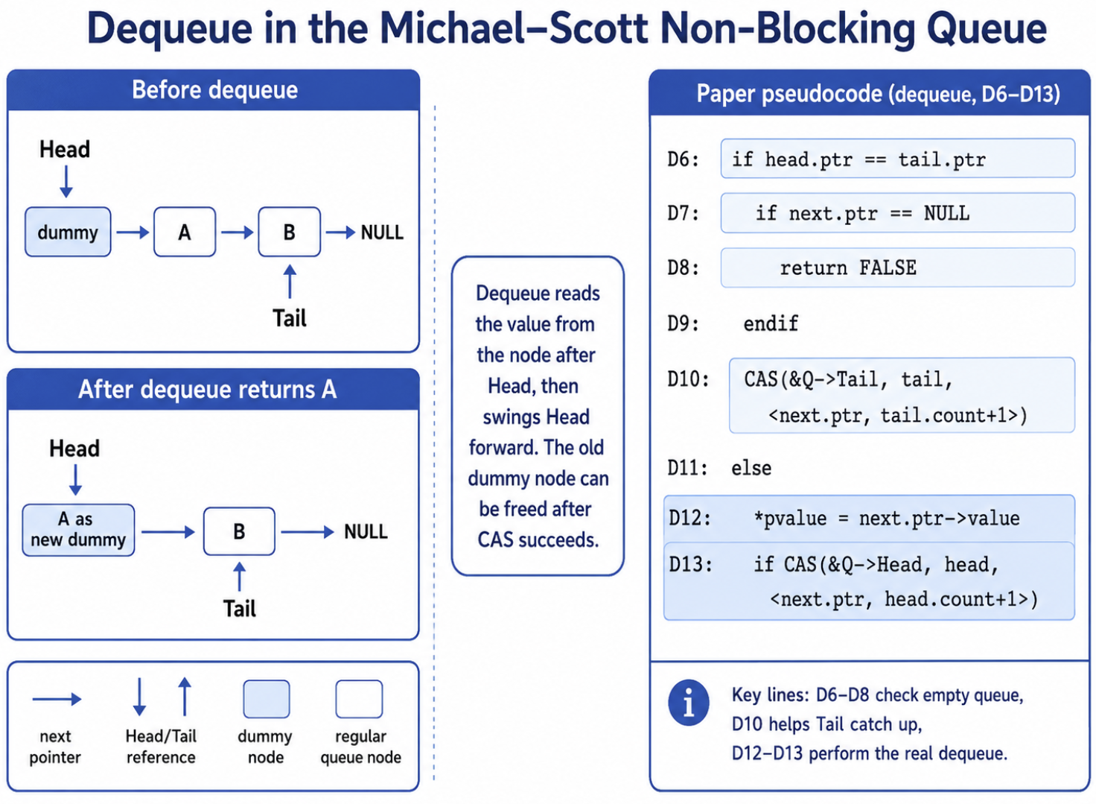
Dequeue Operation: Move Head Forward
Dequeue reads Head, Tail, and Head->next.
If Head == Tail and Head->next == NULL, the queue is empty.
Otherwise, the value is read from Head->next.
The successful CAS moving Head forward is the logical dequeue point.
Afterward, the old dummy node can be freed.
Dequeue returns the value in Head->next, then advances Head so the removed node becomes the new dummy node.

Slide 8
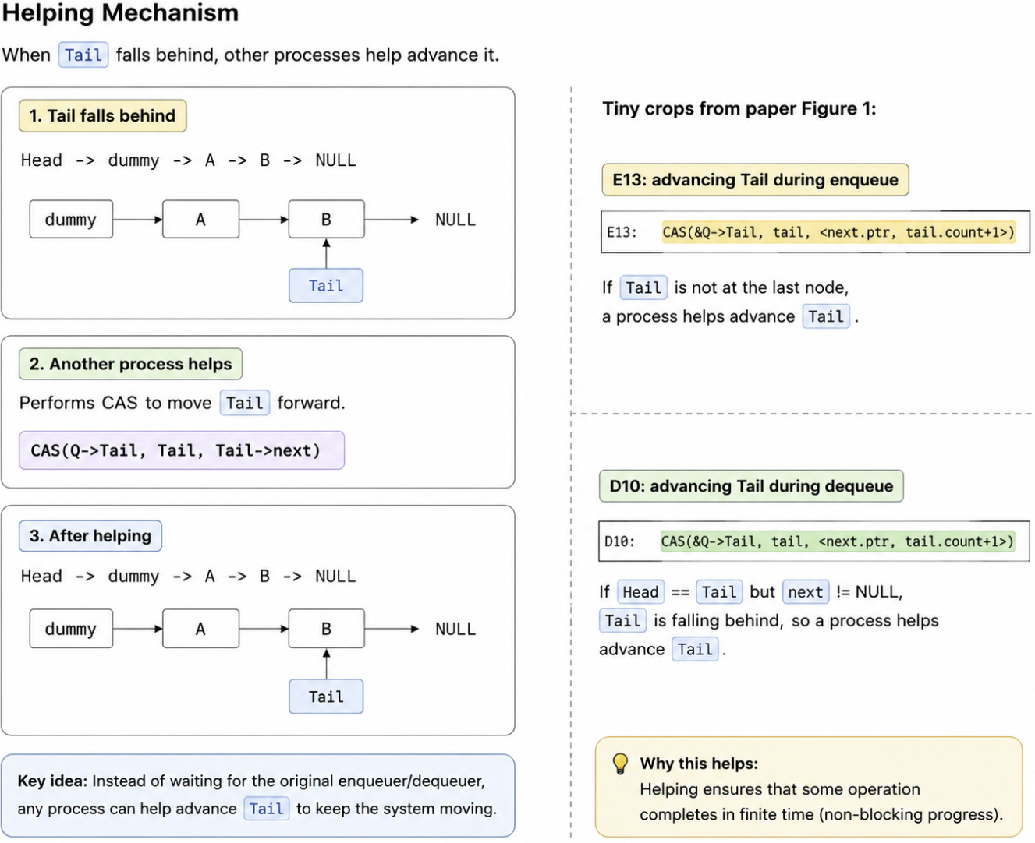
Helping Mechanism and Non-Blocking Progress
Tail is allowed to temporarily lag behind the real last node.
If another process sees this, it helps advance Tail.
This appears in both enqueue and dequeue paths.
A failed CAS usually means another process changed the structure first.
This is why the system as a whole continues making progress.
When Tail lags behind, other processes can help advance it instead of waiting for the delayed process that created the lag.

Slide 9
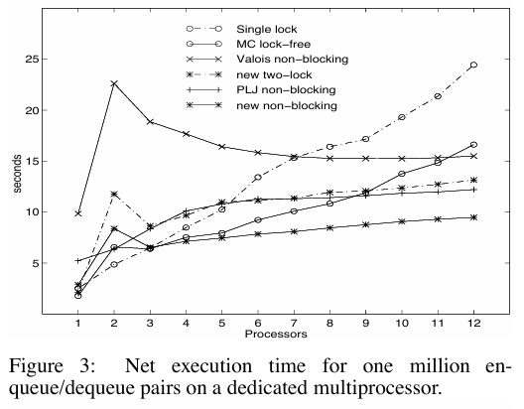
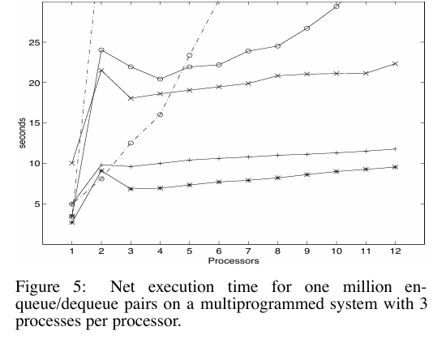
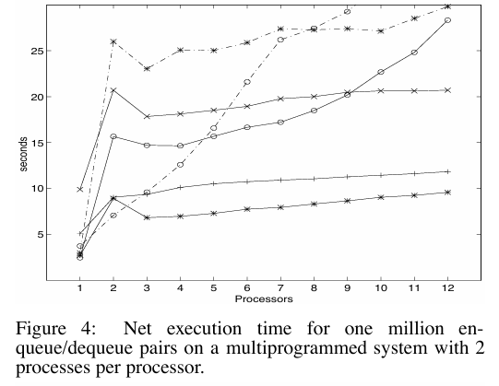
Results: Dedicated vs. Multiprogrammed Systems
The performance graphs show that the new non-blocking queue remains the strongest overall result, while blocking algorithms suffer more as multiprogramming increases.
Figure 4: Multiprogrammed system with 2 processes per processor
Figure 3: Dedicated multiprocessor
Figure 5: Multiprogrammed system with 3 processes per processor

Slide 10
Results: Dedicated vs. Multiprogrammed Systems
Paper Figure | Setup | Main Observation
Figure 3 | Dedicated processors | New non-blocking queue performs best overall after several processors
Figure 4 | 2 processes per processor | Blocking algorithms degrade more under multiprogramming
Figure 5 | 3 processes per processor | Non-blocking advantage becomes strongest
The main trend across Figures 3–5 is that process delays make blocking queues less reliable, while the non-blocking queue remains more stable.

Slide 11
Thank You For Listening!!
Reference
Maged M. Michael and Michael L. Scott. “Simple, Fast, and Practical Non-Blocking and Blocking Concurrent Queue Algorithms.” Department of Computer Science, University of Rochester.

